Slide 1
Cellular Fundamentals

Slide 2
Roadmap
Evolution to cellular communication
Cellular system generation
Cellular concept
Channel assignment
Capacity increase
Multi path propagation

Slide 3
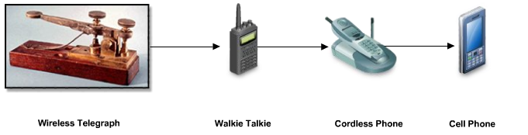
Evolution to cellular communication – communication anytime, anywhere
radio communication was invented by Nokola Tesla and Guglielmo Marconi: in 1893, Nikola Tesla made the first public demonstration of wireless (radio) telegraphy; Guglielmo Marconi conducted long distance (over see) telegraphy 1897
in 1940 the first walkie-talkie was used by the US military
in 1947, John Bardeen and Walter Brattain from AT&T’s Bell Labs invented the transistor (semiconductor device used to amplify and switch electronic signals)

Slide 4
Evolution to cellular communication – communication anytime, anywhere
AT&T introduced commercial radio comm.: car phone – two way radio link to the local phone network
in 1979 the first commercial cellular phone service was launched by the Nordic Mobile Telephone (in Finland, Sweden, Norway, Denmark).

Slide 5
Cellular systems generations
1G (first generation) – voice-oriented systems based on analog technology; ex.: Advanced Mobile Phone Systems (AMPS) and cordless systems
2G (second generation) - voice-oriented systems based on digital technology; more efficient and used less spectrum than 1G; ex.: Global System for Mobile (GSM) and US Time Division Multiple Access (US-TDMA)

Slide 6
Cellular systems generations
3G (third generation) – high-speed voice-oriented systems integrated with data services; ex.: General Packet Radio Service (GPRS), Code Division Multiple Access (CDMA)
4G (fourth generation) – still experimental, not deployed yet; based on Internet protocol networks and will provide voice, data and multimedia service to subscribers

Slide 7
Frequency reuse
method used by service providers to improve the efficiency of a cellular communication.
Serve millions of subscribers using a limited radio spectrum
Transmitter transmitting in a specific frequency range will have only a limited coverage area
beyond this coverage area, that frequency can be reused by another transmitter.

Slide 8
Cells
the entire network coverage area is divided into cells based on the principle of frequency reuse
Cell - Basic geographical unit of a cellular communication
  area around an antenna where a specific frequency range is used
  represented graphically as a hexagonal shape, but in reality it is irregular in shape
  when a subscriber moves to another cell, the antenna of the new cell takes over the signal transmission
Cluster - group of adjacent cells, usually 7 cells; no frequency reuse is done within a cluster
the frequency spectrum is divided into sub-bands and each sub-band is used within one cell of the cluster
in heavy traffic zones cells are smaller, while in isolated zones cells are larger

Slide 9
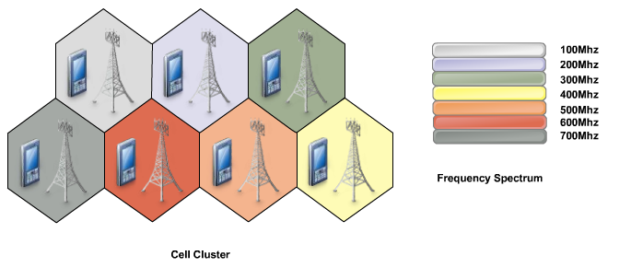
Cells

Slide 10
Types of cells
Macro-cell – coverage is large (aprox. 6 miles in diameter); used in remote areas, high-power transmitters and receivers are used
Micro-cell – coverage is small (half a mile in diameter) and are used in urban zones; low-powered transmitters and receivers are used to avoid interference with cells in another clusters
Pico-cell – covers areas such as building or a tunnel

Slide 11
Cellular services
Voice communication
Short Messaging Service (SMS)
Multimedia Messaging Service (MMS)
Global Positioning System (GPS)
Wireless Application Protocol (WAP) – to access the Internet

Slide 12
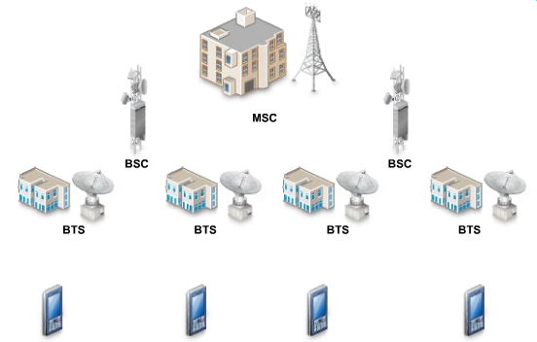
Cellular Communication Components

Slide 13
Cellular Communication components (2)
BTS (Base Transceiver Station) – main component of a cell and it connects the subscribers to the cellular network; for transmission/reception of information it uses several antennas spread across the cell
BSC (Basic Station Controller) – it is an interface between BTSs and it is linked to BTSs by cable or microwave links; it routes calls between BTSs; it is also connected to the MSC
MSC (Mobile Switching Center) – the coordinator of a cellular network, it is connected to several BSCs, it routes calls between BSCs; links the cellular network with other networks like PSTN through fiber optics, microwave or copper cable

Slide 14






Components of a cellular phone (MSU – Mobile Subscriber Unit)
radio transceiver – low power radio transmitter and receiver
antenna, usually located inside the phone
control circuitry – formats the data sent to and from the BTS; controls signal transmission and reception
man-machine interface – consists from a keypad and a display; is managed by the control circuitry
Subscriber Identity Module (SIM) – integrated circuit card that stores the identity information of subscriber
battery, usually Li-ion, the power unit of the phone

Slide 15
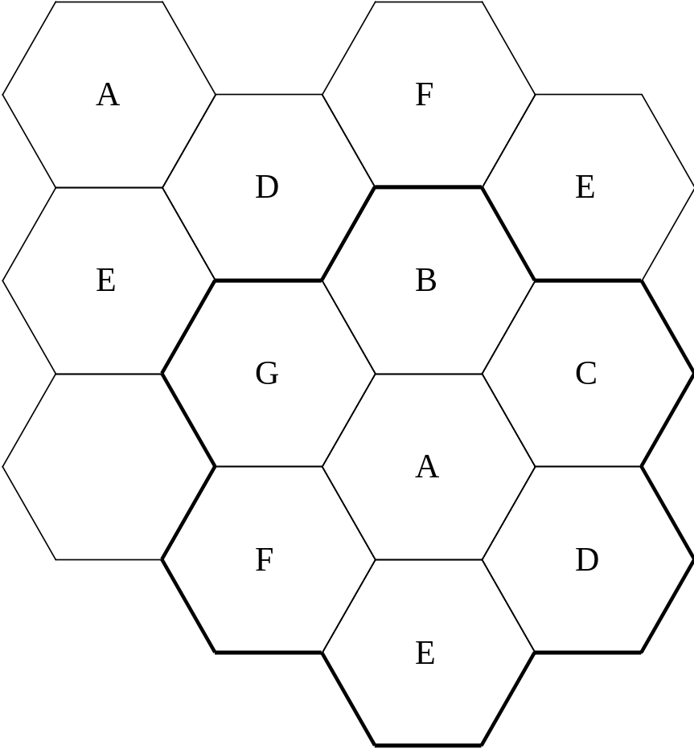
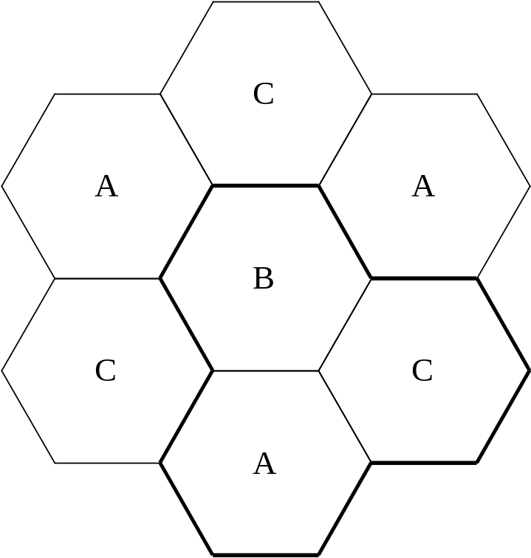
The factor N is called the cluster size and is given
N=i²+ij+j²

Slide 16
To find the nearest co-channel neighbor of a particular cell, one must do the following:
move i cells along any chain of hexagons and then
turn 60 degrees counter-clockwise and move j cells.

Slide 17
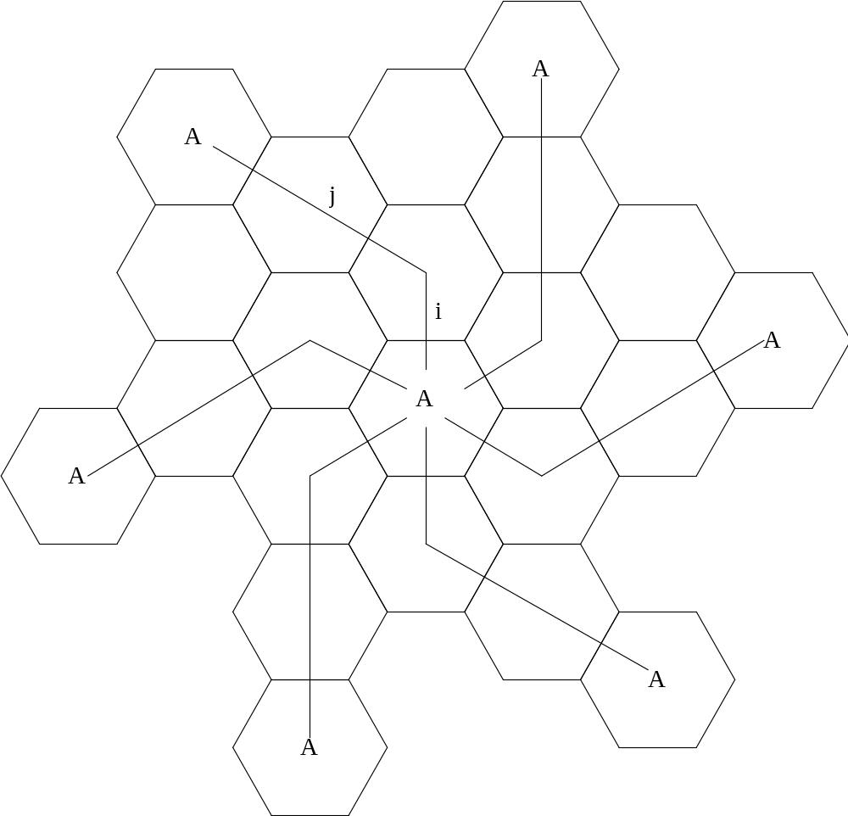
i=1, j=2 , N=1+2+4=7

Slide 18
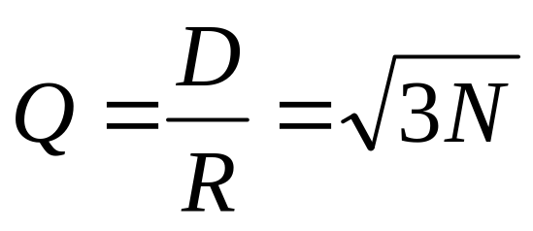
Interference
R - the radius of the cell
D - the distance between centers of the nearest co-channel cells
Q - the co-channel reuse ratio

Slide 19
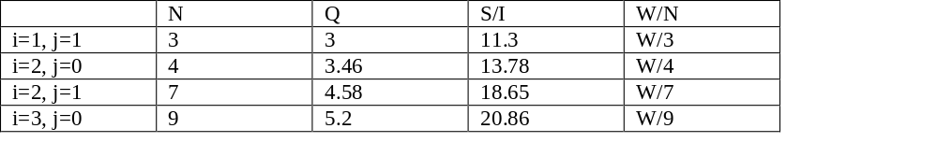
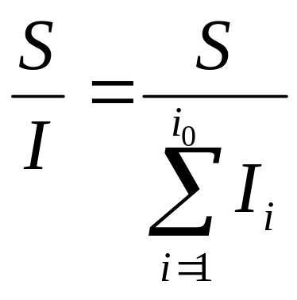
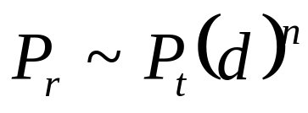
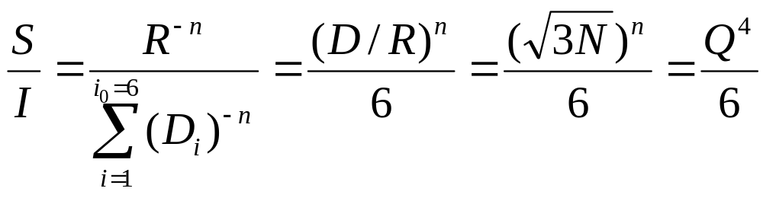
Table 1. Co-channel reuse ratio, S/I for some values of N

Slide 20
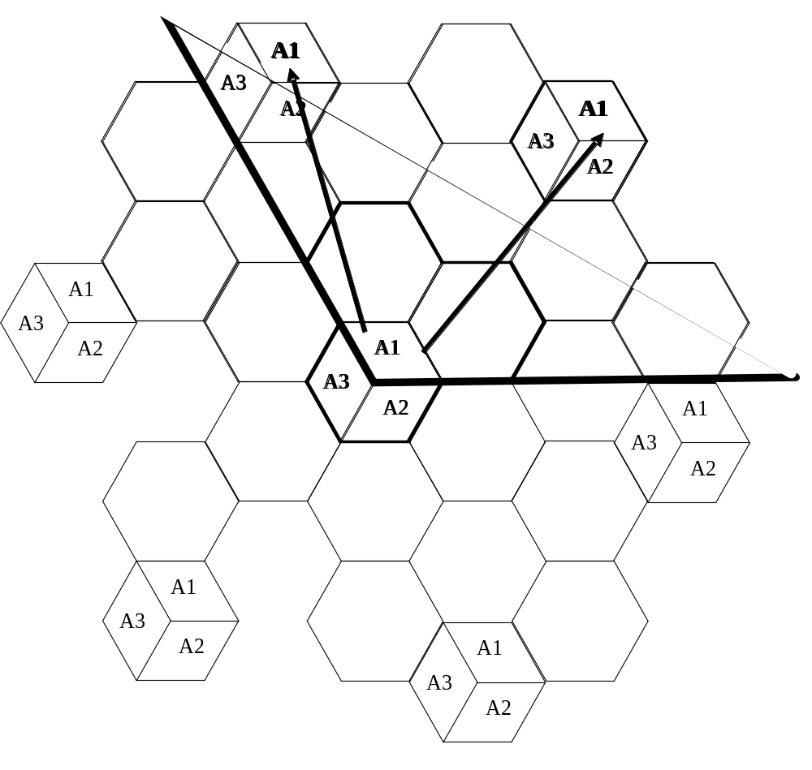
Decreasing the co channel interference - sectorisation

Slide 21
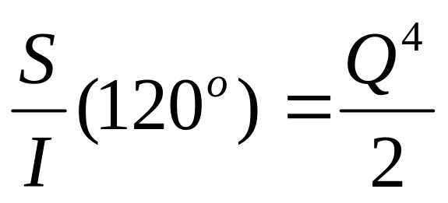
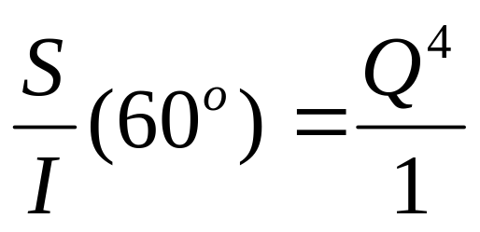
Decreasing the co channel interference - sectorisation
Table 2. Co-channel reuse ratio, S/I for values of N=7 using sectorial structure

Slide 22
Setting up a call process
when powered on, the phone does not have a frequency/ time slot/ode assigned to it yet; so it scans for the control channel of the BTS and picks the strongest signal
then it sends a message (including its identification number) to the BTS to indicate its presence
the BTS sends an acknowledgement message back to the cell phone
the phone then registers with the BTS and informs the BTS of its exact location
after the phone is registered to the BTS, the BTS assigns a channel to the phone and the phone is ready to receive or make calls

Slide 23
Making a call process
the subscriber dials the receiver’s number and sends it to the BTS
the BTS sends to its BSC the ID, location and number of the caller and also the number of the receiver
the BSC forwards this information to its MSC
the MSC routes the call to the receiver’s MSC which is then sent to the receiver’s BSC and then to its BTS
the communication with the receiver’s cell phone is established

Slide 24
Receiving a call process
when the receiver’ phone is in an idle state it listens for the control channel of its BTS
if there is an incoming call the BSC and BTS sends a message to the cells in the area where the receiver’s phone is located
the phone monitors its message and compares the number from the message with its own
if the numbers matches the cell phone sends an acknowledgement to the BTS
after authentication, the communication is established between the caller and the receiver

Slide 25
Traffic Channel Allocation

Slide 26
What is channel allocation?
Given radio spectrum is divided into a set of disjointed channels that can be used simultaneously while minimizing interference in adjacent channel by allocating channels appropriately (especially for traffic channels).
Channel allocation schemes can be divided into:
  Fixed Channel Allocation schemes (FCA schemes);
  Dynamic Channel Allocation schemes (DCA schemes);
  Hybrid Channel Allocation schemes (HCA schemes: combining both FCA and DCA techniques);

Slide 27
Fixed Channel Allocation (FCA)
In FCA schemes, a set of channels is permanently allocated to each cell in the network.
If the total number of available channels in the system S is divided into sets, the minimum number of channel sets N required to serve the entire coverage area R is related to the frequency reuse distance D as follows:
N = D² / 3R²
Due to short term fluctuations in the traffic, FCA schemes are often not able to maintain high quality of service and capacity attainable with static traffic demands. One approach to address this problem is to borrow free channels from neighboring cells.

Slide 28
Simple Borrowing (CB) Schemes
In CB schemes, cell (acceptor cell) that has used all its nominal channels can borrow free channels from its neighboring cell (donor cell) to accommodate new calls.
Borrowing can be done from an adjacent cell which has largest number of free channels (borrowing from the richest)
Select the first free channel found for borrowing using a search algorithm (borrow first available scheme)
Return the borrowed channel when channel becomes free in the cell (basic algorithm with reassignment)
To be available for borrowing, the channel must not interfere with existing calls, as shown in the next figure.

Slide 29
Dynamic Channel Allocation (DCA)
In DCA schemes, all channels are kept in a central pool and are assigned dynamically to new calls as they arrive in the system.
After each call is completed, the channel is returned to the central pool. It is fairly straightforward to select the most appropriate channel for any call based simply on current allocation and current traffic, with the aim of minimizing the interference.
DCA scheme can overcome the problem of FCA scheme. However, variations in DCA schemes center around the different cost functions used for selecting one of the candidate channels for assignment.

Slide 30
Dynamic Channel Allocation (DCA)
DCA schemes can be centralized or distributed.
The centralized DCA scheme involves a single controller selecting a channel for each cell;
The distributed DCA scheme involves a number of controllers scattered across the network (MSCs).
Centralized DCA schemes can theoretically provide the best performance. However, the enormous amount of computation and communication among BSs leads to excessive system latencies and renders centralized DCA schemes impractical. Nevertheless, centralized DCA schemes often provide a useful benchmark to compare practical decentralized DCA schemes.

Slide 31
Centralized DCA
For a new call, a free channel from the central pool is selected that would maximize the number of members in its co-channel set.
Minimize the mean square of distance between cells using the same channel.

Slide 32
Distributed DCA Schemes
Based on one of the three parameters:
  Co-channel distance
  - co-channel cells in the neighborhood not using the channel
  - sometimes adjacent channel interference taken in to account
  Signal strength measurement
  - anticipated CIR above threshold
  Signal to noise interference ratio
  - satisfy desired CIR ratio

Slide 33
Comparison between FCA and DCA
FCA | DCA
Performs better under heavy traffic Low flexibility in channel assignment Maximum channel reusability Sensitive to time and spatial changes Not stable grade of service per cell in an interference cell group High forced call termination probability Suitable for large cell environment Low flexibility | Performs better under light/moderate traffic Flexible channel allocation Not always maximum channel reusability Insensitive to time and time spatial changes Stable grade of service per cell in an interference cell group Low to moderate forced call termination probability Suitable in microcellular environment High flexibility

Slide 34
Comparison between FCA and DCA
FCA | DCA
Radio equipment covers all channels assigned to the cell Independent channel control Low computational effort Low call set up delay Low implementation complexity Complex, labor intensive frequency planning Low signaling load Centralized control | Radio equipment covers the temporary channel assigned to the cell Fully centralized to fully distributed control dependent on the scheme High computational effort Moderate to high call set up delay Moderate to high implementation complexity No frequency planning Moderate to high signaling load Centralized, distributed control depending on the scheme

Slide 35
Other Channel Allocation Schemes
Based on different criterion being used as a potential way of optimizing the performance, many other channel allocation schemes have been suggested.
  Hybrid Channel Allocation (HCA)
  Flexible Channel Allocation (FCA)

Slide 36
Hybrid Channel Allocation (HCA)
HCA schemes are the combination of both FCA and DCA techniques.
In HCA schemes, the total number of channels available for service is divided into fixed and dynamic sets.
  The fixed set contains a number of nominal channels that are assigned to cells as in the FCA schemes and, in all cases, are to be preferred for use in their respective cells.
  The dynamic set is shared by all users in the system to increase flexibility.
  Example: When a call requires service from a cell and all of its nominal channels are busy, a channel from the dynamic set is assigned to the call.

Slide 37
Hybrid Channel Allocation (HCA)
Request for a channel from the dynamic set is initiated only when the cell has exhausted using all its channels from the fixed set.
Optimal ratio: ratio of number of fixed and dynamic channels.
3:1 (fixed to dynamic), provides better service than fixed scheme for 50% traffic.
Beyond 50% fixed scheme perform better.
For dynamic, with traffic load of 15% to 32%, better results are found with HCA.

Slide 38
Flexible Channel Allocation (FCA)
Similar to hybrid scheme with channels divided into fixed and flexible (emergency) sets.
Fixed sets used to handle lighter loads.
Variations in traffic (peaks in time and space) are needed to schedule emergency channels.
Two types: Scheduled and Predictive
Scheduled: Prior estimate is done about traffic change
Predictive: Traffic intensity and blocking probability is monitored in each cell all the time.

Slide 39
Increasing Capacity
add new channels
  not all channels used to start with
frequency borrowing
  taken from adjacent cells by congested cells
  or assign frequencies dynamically
cell splitting
  non-uniform topography and traffic distribution
  use smaller cells in high use areas
Notes:
In time, as more customers use the system, traffic may build up so that there are not enough frequencies assigned to a cell to handle its calls. A number of approaches have been used to cope with this situation, including the following:
• Adding new channels: Typically, when a system is set up in a region, not all of the channels are used, and growth and expansion can be managed in an orderly fashion by adding new channels.
• Frequency borrowing: In the simplest case, frequencies are taken from adjacent cells by congested cells. The frequencies can also be assigned to cells dynamically.
Cell splitting: In practice, the distribution of traffic and topographic features is not uniform, and this presents opportunities for capacity increase. Cells in areas of high usage can be split into smaller cells.

Slide 40
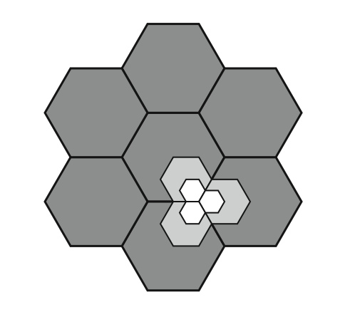
Cell Splitting
Notes:
Cells in areas of high usage can be split into smaller cells. Generally, the original cells are about 6.5 to 13 km in size. The smaller cells can themselves be split; however, 1.5-km cells are close to the practical minimum size as a general solution (but see the subsequent discussion of microcells). To use a smaller cell, the power level used must be reduced to keep the signal within the cell. Also, as the mobile units move, they pass from cell to cell, which requires transferring of the call from one base transceiver to another. This process is called a handoff. As the cells get smaller, these handoffs become much more frequent. Stallings DCC8e Figure 14.3 indicates schematically how cells can be divided to provide more capacity. A radius reduction by a factor of F reduces the coverage area and increases the required number of base stations by a factor of F².

Slide 41
Increasing Capacity
cell sectoring
  cell divided into wedge shaped sectors (3–6 per cell)
  each with own channel set
  directional antennas
microcells
  move antennas from tops of hills and large buildings to tops of small buildings and sides of large buildings
  use reduced power to cover a much smaller area
  good for city streets, roads, inside large buildings
Notes:
Additional approaches to increase capacity include:
• Cell sectoring: With cell sectoring, a cell is divided into a number of wedge-shaped sectors, each with its own set of channels, typically three or six sectors per cell. Each sector is assigned a separate subset of the cell's channels, and directional antennas at the base station are used to focus on each sector.
• Microcells: As cells become smaller, antennas move from the tops of tall buildings or hills, to the tops of small buildings or the sides of large buildings, and finally to lamp posts, where they form microcells. Each decrease in cell size is accompanied by a reduction in the radiated power levels from the base stations and the mobile units. Microcells are useful in city streets in congested areas, along highways, and inside large public buildings.
The use of smaller cells enables the use of lower power and provides superior propagation conditions.

Slide 42
Mobile Radio
Propagation Effects
signal strength
  strength of signal between BS and mobile unit strong enough to maintain signal quality at the receiver
  not too strong to create cochannel interference
  must handle variations in noise
fading
  time variation of received signal
  caused by changes in transmission path(s)
  even if signal strength in effective range, signal propagation effects may disrupt the signal
Notes:
Mobile radio communication introduces complexities not found in wire communication or in fixed wireless communication. Two general areas of concern are signal strength and signal propagation effects.
Signal strength: The strength of the signal between the base station and the mobile unit must be strong enough to maintain signal quality at the receiver but no so strong as to create too much cochannel interference with channels in another cell using the same frequency band. Several complicating factors exist. Human-made noise varies considerably, resulting in a variable noise level. For example, automobile ignition noise in the cellular frequency range is greater in the city than in a suburban area. Other signal sources vary from place to place. The signal strength varies as a function of distance from the BS to a point within its cell. Moreover, the signal strength varies dynamically as the mobile unit moves.
Fading: The term fading refers to the time variation of received signal power caused by changes in the transmission medium or path(s). In a fixed environment, fading is affected by changes in atmospheric conditions, such as rainfall. But in a mobile environment, where one of the two antennas is moving relative to the other, the relative location of various obstacles changes over time, creating complex transmission effects. Even if signal strength is within an effective range, signal propagation effects may disrupt the signal and cause errors.

Slide 43
Design Factors
propagation effects
max transmit power level at BS and mobile units
typical height of mobile unit antenna
available height of the BS antenna
these factors determine size of individual cell
use model based on empirical data
eg. model by Okumura et al & refined by Hata
  detailed analysis of tokyo area
  produced path loss info for an urban environment
  Hata's model is an empirical formulation
Notes:
In designing a cellular layout, the communications engineer must take account of these various propagation effects, the desired maximum transmit power level at the base station and the mobile units, the typical height of the mobile unit antenna, and the available height of the BS antenna. These factors will determine the size of the individual cell. Unfortunately, as just described, the propagation effects are dynamic and difficult to predict. The best that can be done is to come up with a model based on empirical data and to apply that model to a given environment to develop guidelines for cell size. One of the most widely used models was developed by Okumura et al [OKUM68] and subsequently refined by Hata [HATA80]. The original was a detailed analysis of the Tokyo area and produced path loss information for an urban environment. Hata's model is an empirical formulation that takes into account a variety of environments and conditions. See text for more details.

Slide 44
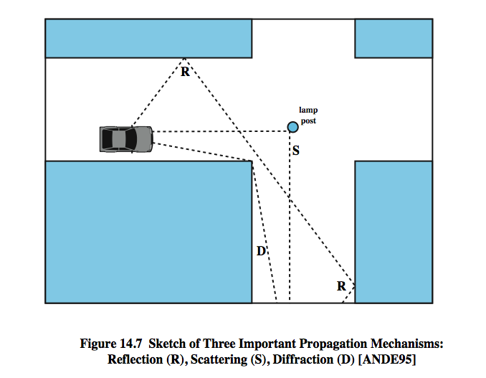
Multipath Propagation
Notes:
Three propagation mechanisms, illustrated in Stallings DCC8e Figure 14.7, play a role. These three propagation effects influence system performance in various ways depending on local conditions and as the mobile unit moves within a cell.
Reflection occurs when an electromagnetic signal encounters a surface that is large relative to the wavelength of the signal. For example, suppose a ground-reflected wave near the mobile unit is received. Because the ground-reflected wave has a 180º phase shift after reflection, the ground wave and the line-of-sight (LOS) wave may tend to cancel, resulting in high signal loss. Further, because the mobile antenna is lower than most human-made structures in the area, multipath interference occurs. These reflected waves may interfere constructively or destructively at the receiver.
Diffraction occurs at the edge of an impenetrable body that is large compared to the wavelength of the radio wave. When a radio wave encounters such an edge, waves propagate in different directions with the edge as the source. Thus, signals can be received even when there is no unobstructed LOS from the transmitter.
If the size of an obstacle is on the order of the wavelength of the signal or less, scattering occurs. An incoming signal is scattered into several weaker outgoing signals. At typical cellular microwave frequencies, there are numerous objects, such as lamp posts and traffic signs, that can cause scattering. Scattering effects are difficult to predict.

Slide 45
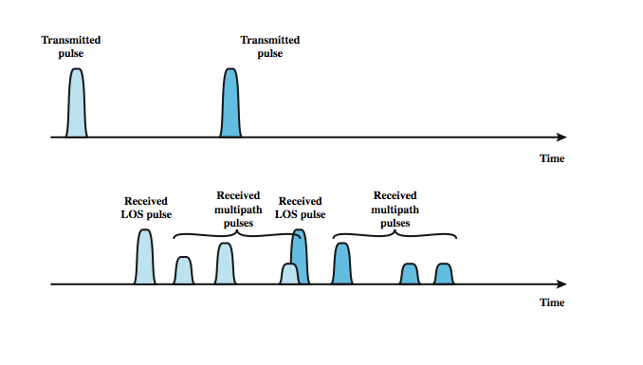
Effects of Multipath Propagation
Notes:
As just noted, one unwanted effect of multipath propagation is that multiple copies of a signal may arrive at different phases. If these phases add destructively, the signal level relative to noise declines, making signal detection at the receiver more difficult. A second phenomenon, of particular importance for digital transmission, is intersymbol interference (ISI). Consider that we are sending a narrow pulse at a given frequency across a link between a fixed antenna and a mobile unit. Stallings DCC8e Figure 14.8 shows what the channel may deliver to the receiver if the impulse is sent at two different times. The upper line shows two pulses at the time of transmission. The lower line shows the resulting pulses at the receiver. In each case the first received pulse is the desired LOS signal. The magnitude of that pulse may change because of changes in atmospheric attenuation. Further, as the mobile unit moves farther away from the fixed antenna, the amount of LOS attenuation increases. But in addition to this primary pulse, there may be multiple secondary pulses due to reflection, diffraction, and scattering. Now suppose that this pulse encodes one or more bits of data. In that case, one or more delayed copies of a pulse may arrive at the same time as the primary pulse for a subsequent bit. These delayed pulses act as a form of noise to the subsequent primary pulse, making recovery of the bit information more difficult. As the mobile antenna moves, the location of various obstacles changes; hence the number, magnitude, and timing of the secondary pulses change. This makes it difficult to design signal processing techniques that will filter out multipath effects so that the intended signal is recovered with fidelity.

Slide 46
Types of Fading
fast fading
  rapid changes in strength over half wavelength distances
    eg. 900MHz wavelength is 0.33m see 20-30dB
slow fading
  slower changes due to user passing different height buildings, gaps in buildings etc.
  over longer distances than fast fading
flat fading
  affects all frequencies in same proportion
selective fading
  different frequency components affected differently
Notes:
Fading effects in a mobile environment can be classified as either fast or slow. Referring to Stallings DCC8e Figure 14.7, as the mobile unit moves down a street in an urban environment, rapid variations in signal strength occur over distances of about one-half a wavelength. At a frequency of 900 MHz, which is typical for mobile cellular applications, a wavelength is 0.33 m. Changes of amplitude can be as much as 20 or 30 dB over a short distance. This type of rapidly changing fading phenomenon, known as fast fading, affects not only mobile phones in automobiles, but even a mobile phone user walking down an urban street. As the mobile user covers distances well in excess of a wavelength, the urban environment changes, as the user passes buildings of different heights, vacant lots, intersections, and so forth. Over these longer distances, there is a change in the average received power level about which the rapid fluctuations occur. This is referred to as slow fading.
Fading effects can also be classified as flat or selective. Flat fading, or nonselective fading, is that type of fading in which all frequency components of the received signal fluctuate in the same proportions simultaneously. Selective fading affects unequally the different spectral components of a radio signal. The term selective fading is usually significant only relative to the bandwidth of the overall communications channel. If attenuation occurs over a portion of the bandwidth of the signal, the fading is considered to be selective; nonselective fading implies that the signal bandwidth of interest is narrower than, and completely covered by, the spectrum affected by the fading.

Slide 47
Summary
principles of wireless cellular communication
operation of wireless cellular communication
Generations
Channel assignment
Mobile propagation model

